Slide 1
Introduction to git and GitLab

Slide 2
How do you work on your (software) projects? How do you save intermediate results? How do you backup your (software) projects?

Slide 3

Why version control?
“Piled Higher and Deeper” by Jorge Cham, http://www.phdcomics.com

Slide 4
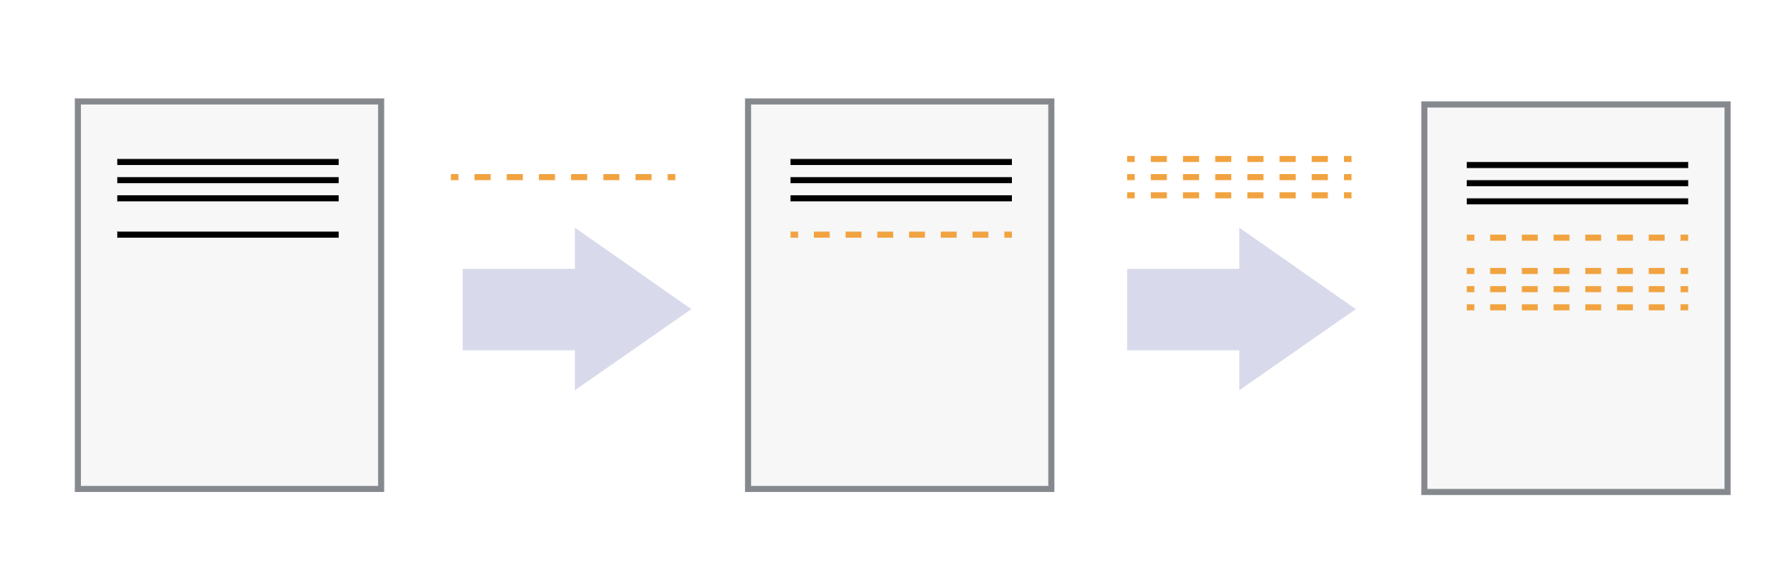
Keeping track of changes
In git terminology: a coherent set of changes is called a ‘commit’

Slide 5
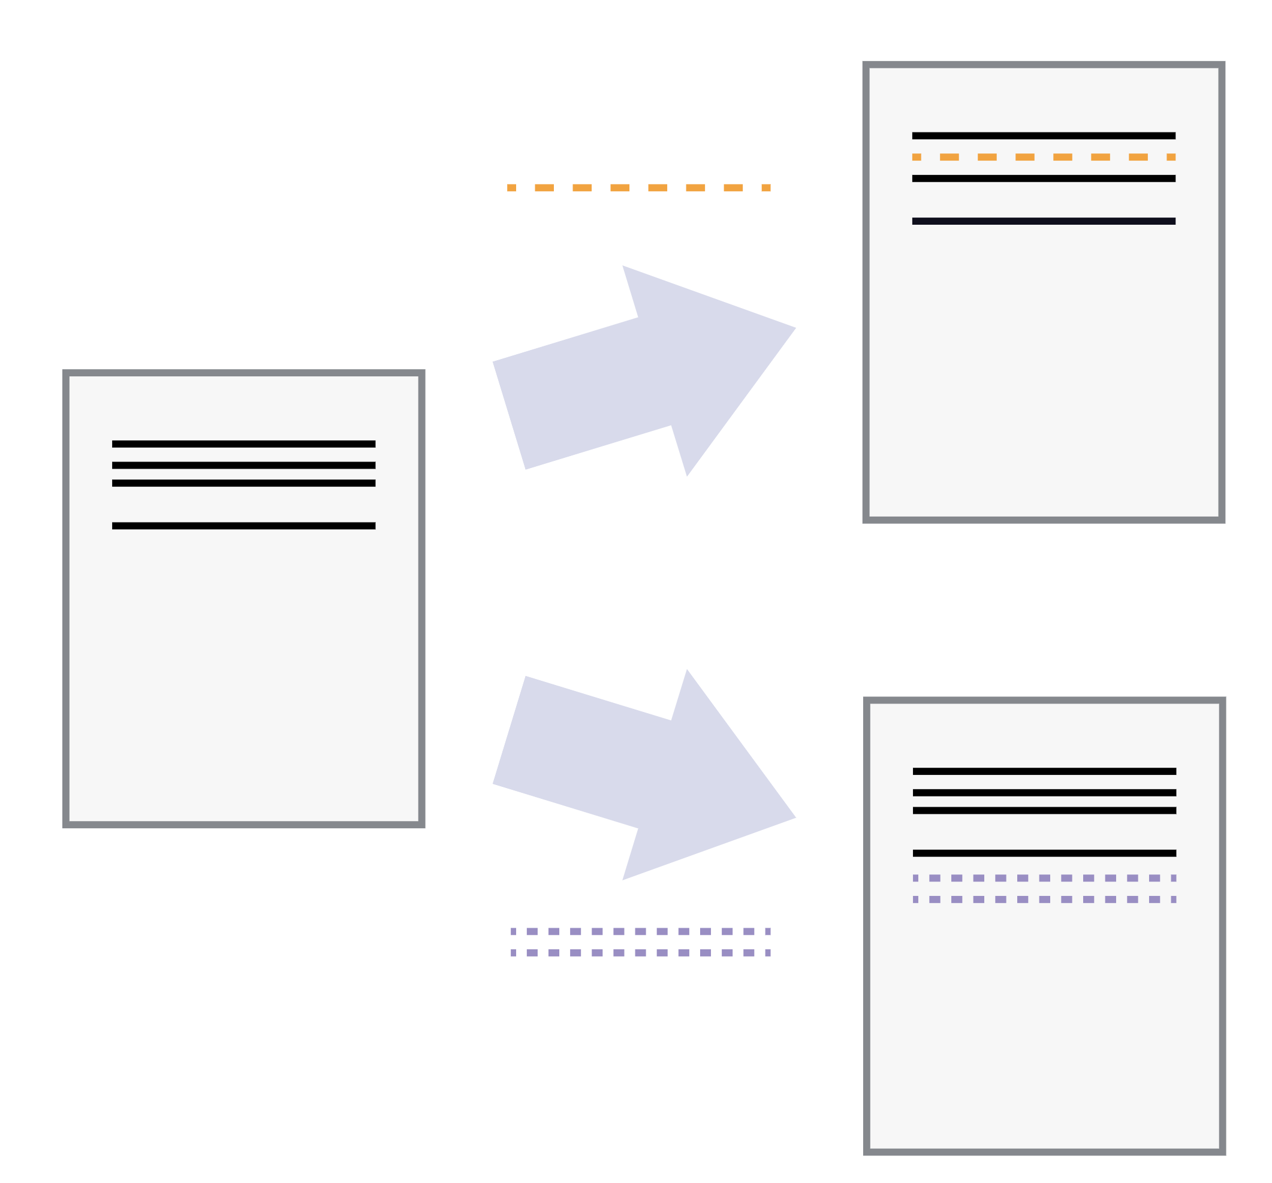
Playing back different sets of changes on the base document

Slide 6
Playing back different sets of changes on the base document

Slide 7
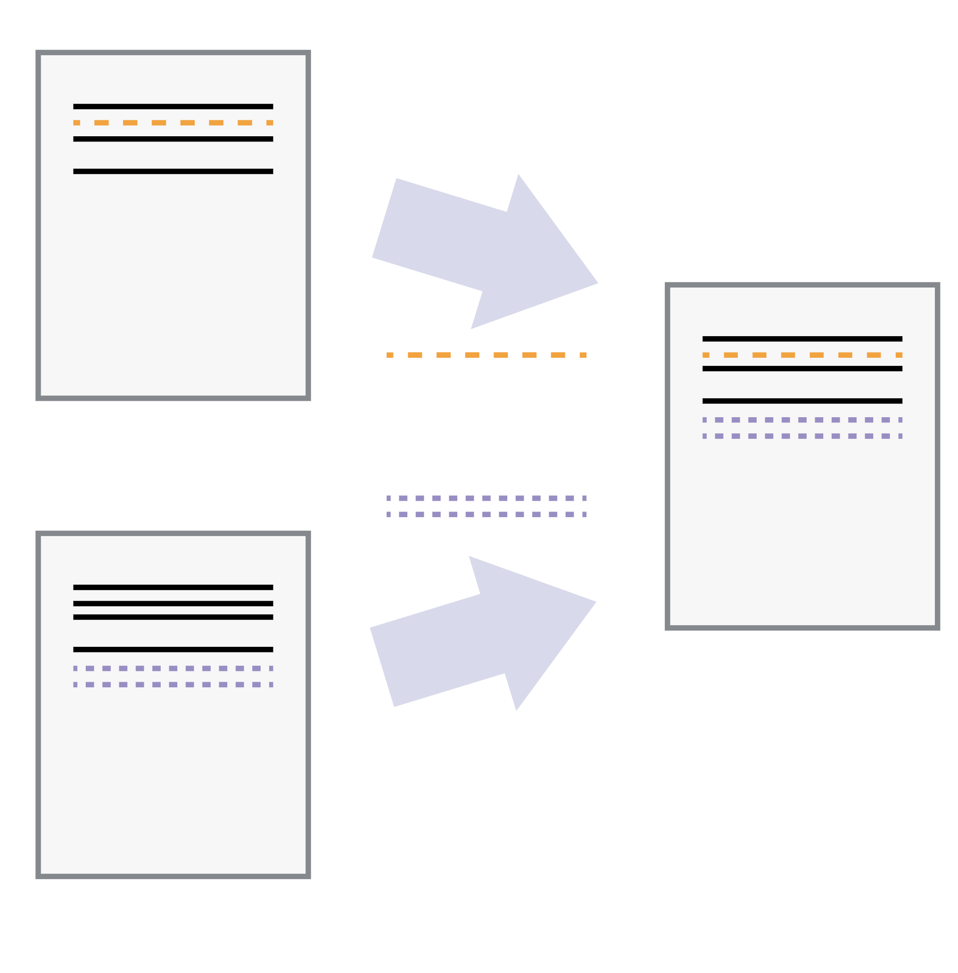
Incorporating two sets of changes into the same base document

Slide 8
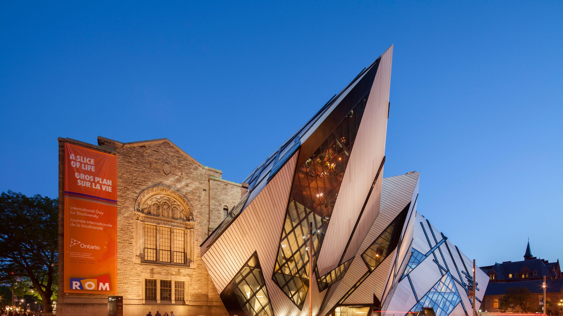
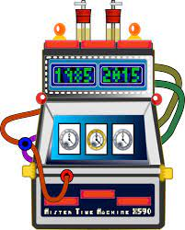
Time machine intuition
Time machine: you can always go back to a previous version of your code
You do not have to roll back the entire project, you can have both old and new parts at the same time.

Slide 9
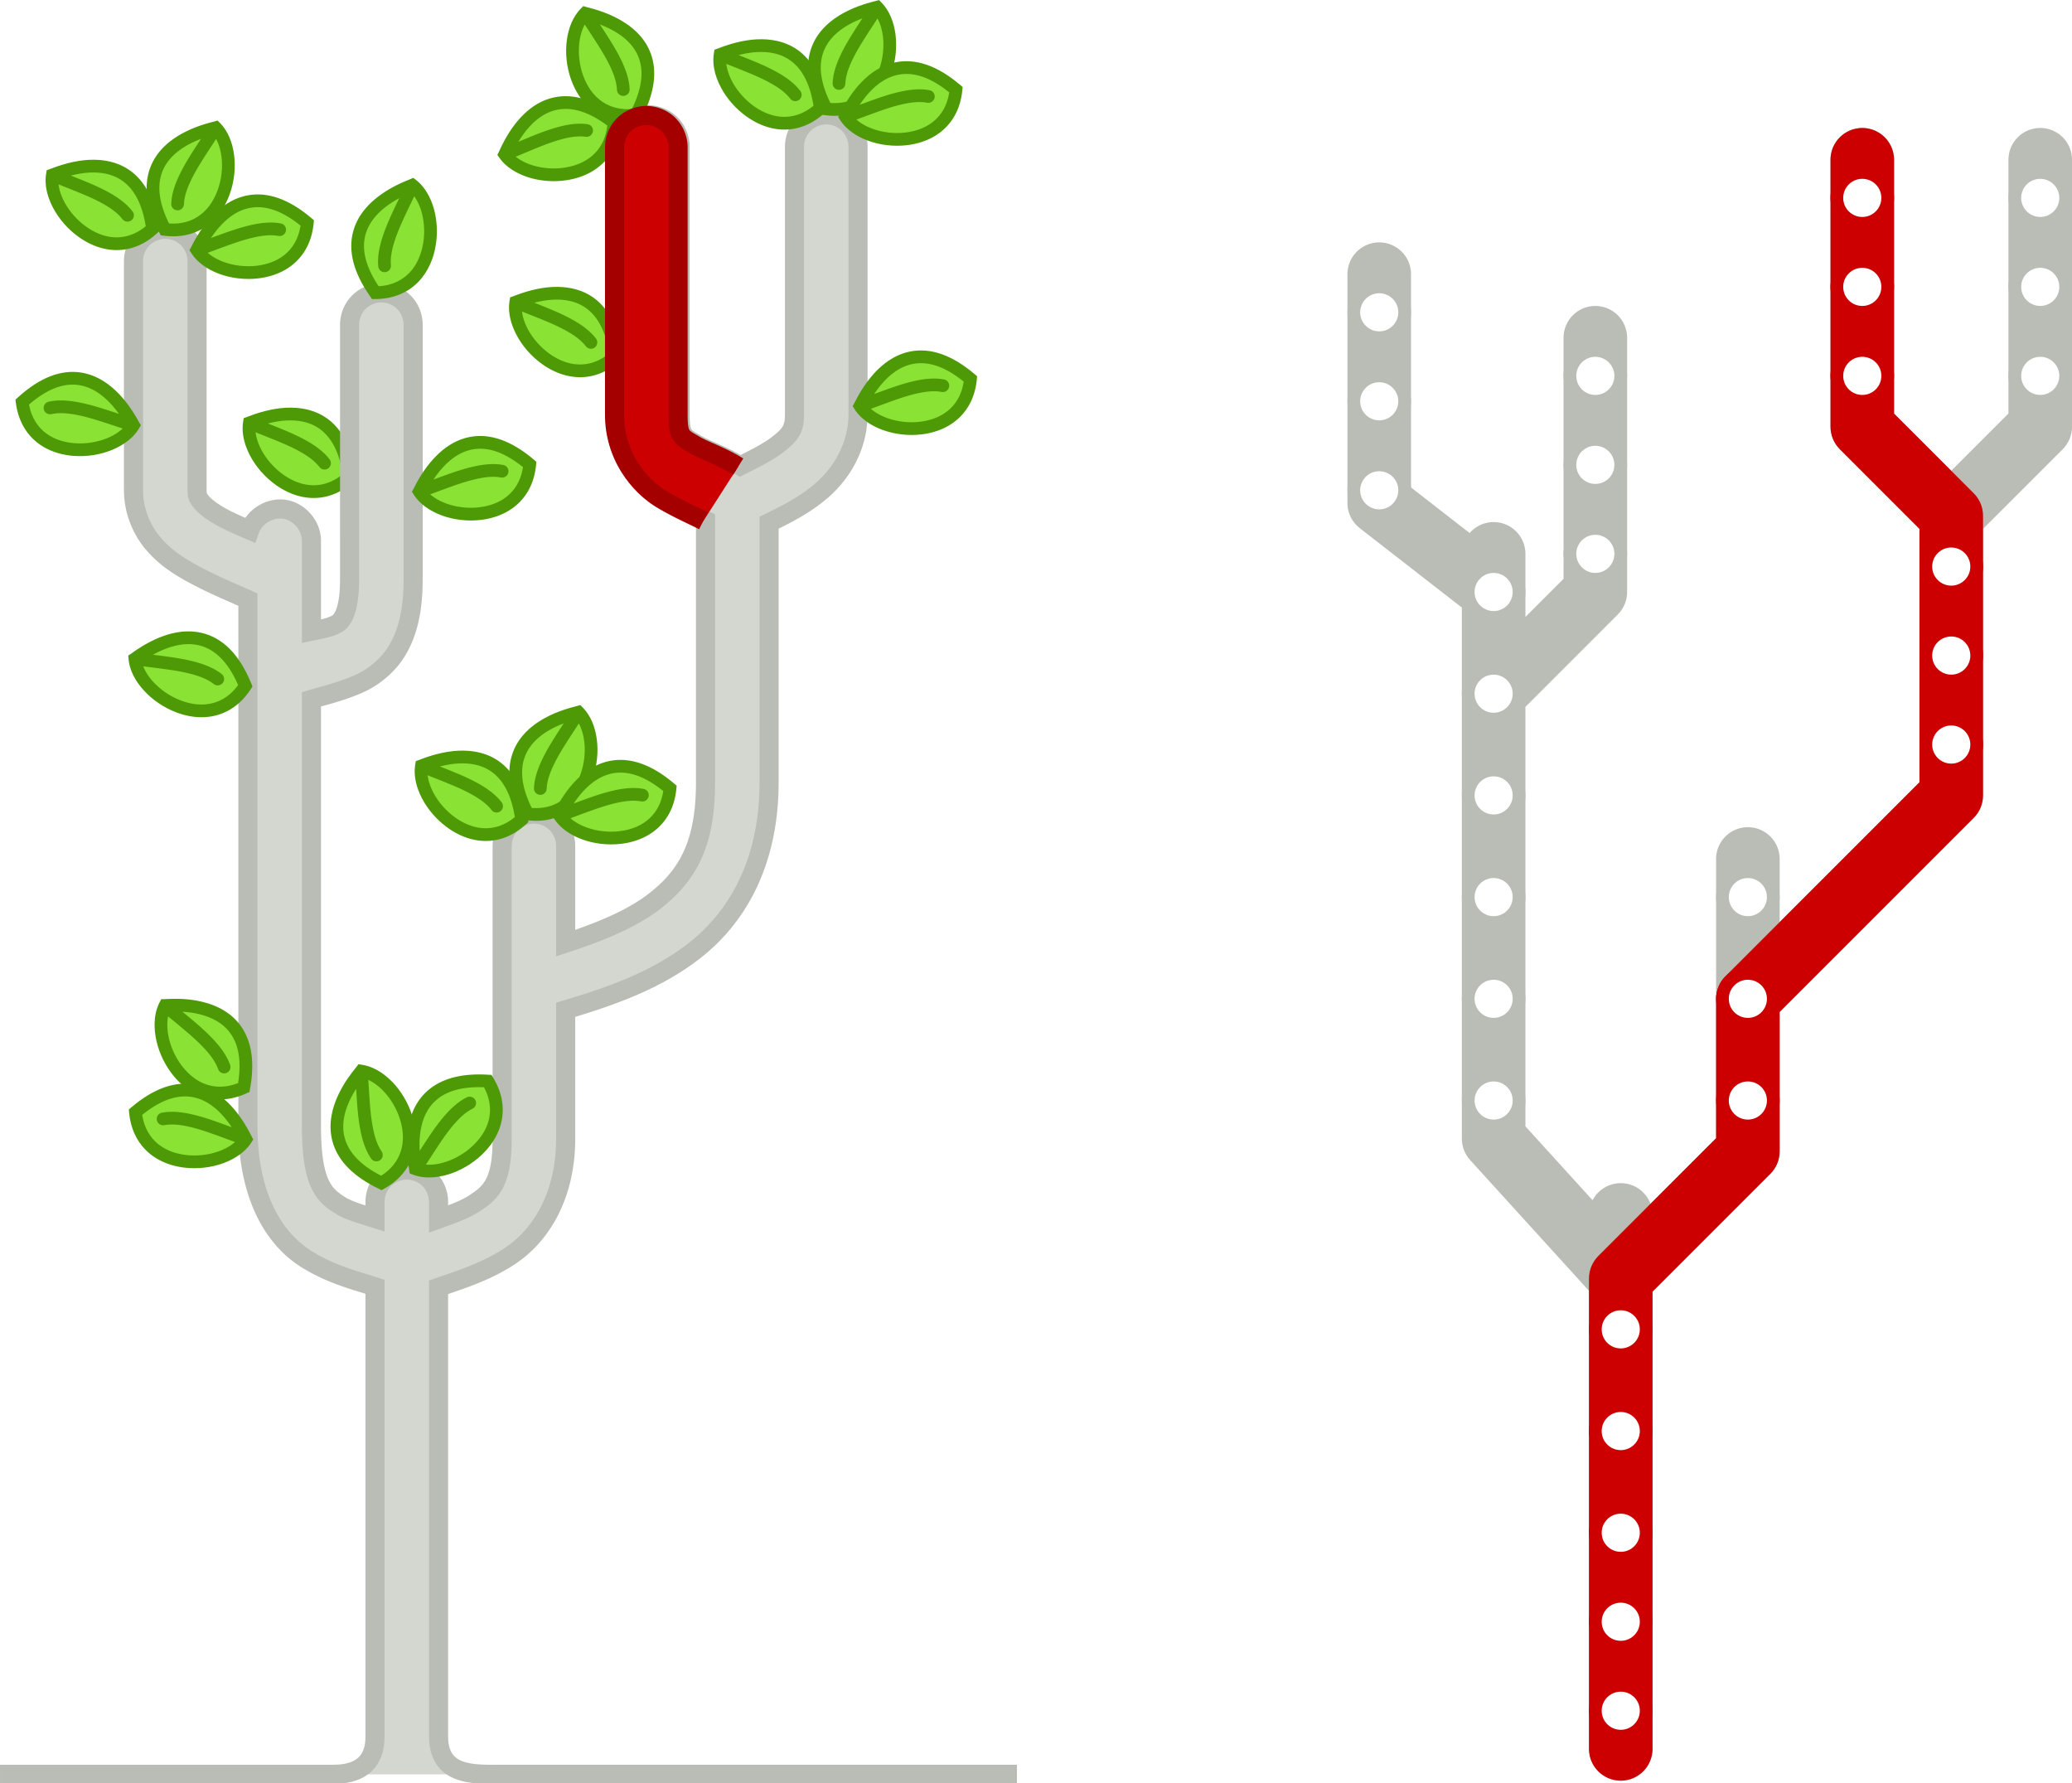
Tree intuition
The tree grows as you add new sets of changes (called ‘commits’) to the base project (the trunk). Sometimes you branch off as you add different commits to parallel versions of the project.

Slide 10
Key points
Version control is like an unlimited ‘undo’. (think of a time machine)
Version control also allows many people to work in parallel. (think of a tree)

Slide 11
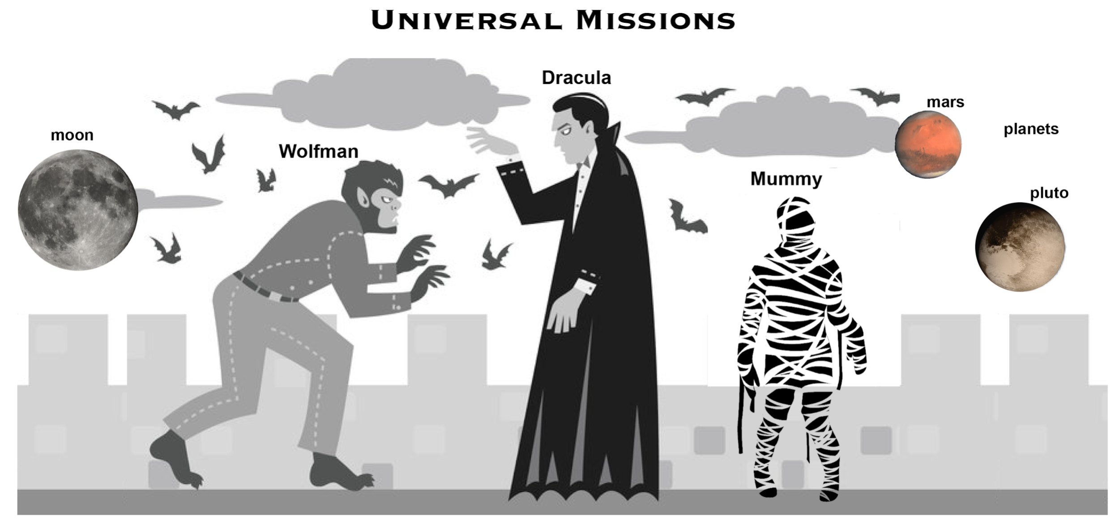
Wolfman and Dracula are investigating if it is possible to send a planetary lander to Mars

Slide 12
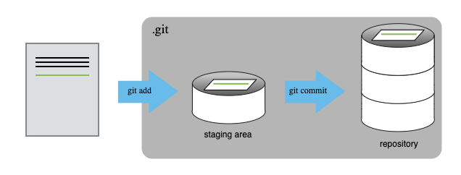

Slide 13
